Slide 1
Python Virtual Environment

Slide 2
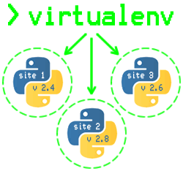
Introduction
A Virtual Environment, put simply, is an isolated working copy of Python which allows you to work on a specific project without worry of affecting other projects.
This means that each project can have its own dependencies, regardless of what dependencies every other project has.

Slide 3
Why do we need a virtual environment?
Imagine a scenario where you are working on two web based python projects and one of them uses a Django 1.9 and the other uses Django 1.10 and so on.
In such situations virtual environment can be really useful to maintain dependencies of both the projects.
A virtual environment is also useful when you need to work on a shared system and do not have permission to install packages as you will be able to install them in the virtual environment.
Notes:
By default, every project on your system will use these same directories to store and retrieve site packages (third party libraries). How does this matter? Now, in the above example of two projects, you have two versions of Django. This is a real problem for Python since it can’t differentiate between versions in the “site-packages” directory. So both v1.9 and v1.10 would reside in the same directory with the same name. This is where virtual environments come into play. To solve this problem, we just need to create two separate virtual environments for both the projects.The great thing about this is that there are no limits to the number of environments you can have since they’re just directories containing a few scripts.
Virtual Environment should be used whenever you work on any Python based project. It is generally good to have one new virtual environment for every Python based project you work on. So the dependencies of every project are isolated from the system and each other.

Slide 4
How does it work?
We use a module named virtualenv which is a tool to create isolated Python environments.
virtualenv creates a folder which contains all the necessary executables to use the packages that a Python project would need.

Slide 5
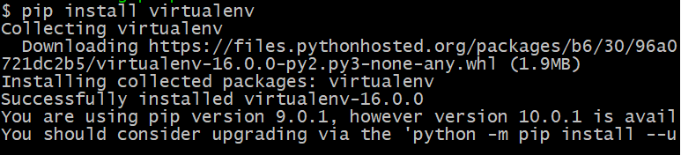
Installing virtualenv
Install it via pip:
pip install virtualenv
Notes:
What does each folder contain?
“bin” - files that interact with the virtual environment
“include” - C headers that compile the Python packages
“lib” - a copy of the Python version along with a “site-packages” folder where each dependency is installed
These files are used to ensure all Python code and commands are executed within the context of the current environment, which is how the isolation from the global environment is achieved. We’ll explain this in more detail in the next section.
More interestingly are the activate scripts in the “bin” directory. These scripts are used to set up your shell to use the environment’s Python executable and its site-packages by default.

Slide 6
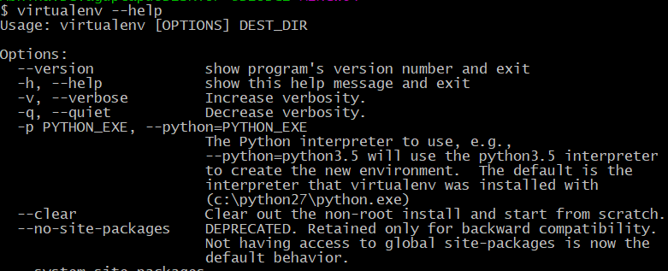
virtualenv Help
Before starting off with any tool, it’s important to know the basic command syntax and the built-in command options.
The “help” option is the built-in facility available for each of the commands and tools.
To use it,
virtualenv --help
Notes:
What does each folder contain?
“bin” - files that interact with the virtual environment
“include” - C headers that compile the Python packages
“lib” - a copy of the Python version along with a “site-packages” folder where each dependency is installed
These files are used to ensure all Python code and commands are executed within the context of the current environment, which is how the isolation from the global environment is achieved. We’ll explain this in more detail in the next section.
More interestingly are the activate scripts in the “bin” directory. These scripts are used to set up your shell to use the environment’s Python executable and its site-packages by default.

Slide 7

Testing the virtualenv Installation
Test your installation:
virtualenv --version
If the installation is successful, this command should give you the version of virtualenv installed.

Slide 8

Creating a Virtual Environment
You can create a virtualenv using the following command:
virtualenv my_env
After running this command, a directory named my_name will be created.
This is the directory which contains all the necessary executables to use the packages that a Python project would need.
This is where Python packages will be installed.

Slide 9

Activating a Virtual Environment
Now after creating virtual environment, you need to activate it. Remember to activate the relevant virtual environment every time you work on the project.
Mac OS / Linux
source my_env/bin/activate
Windows
source my_env/Scripts/activate
You should see the name of your virtual environment in brackets on your terminal line e.g. (my_env)
Notes:
You can then begin installing any new modules without affecting the system default Python or other virtual environments.
Now you can install dependencies related to the project in this virtual environment. For example if you are using Django 1.9 for a project, you can install it like you install other packages.

Slide 10

Testing the Activation
To check if your virtual environment folder is indeed activated, type any python related command. For example, to check where the current python executable is located:
which python
After activating the environment we’re now getting a different path for the python executable because in an active environment the $PATH environment variable is slightly modified.
Notes:
This begs the questions:
What’s the difference between these two executables anyway?
How is the virtual environment’s Python executable able to use something other than the system’s site-packages?
This can be explained by how Python starts up and where it is located on the system. There actually isn’t any difference between these two Python executables. It’s their directory locations that matter.
When Python is starting up, it looks at the path of its binary (which, in a virtual environment, is actually just a copy of, or symlink to, your system’s Python binary). It then sets the location of sys.prefix and sys.exec_prefix based on this location, omitting the “bin” portion of the path.

Slide 11
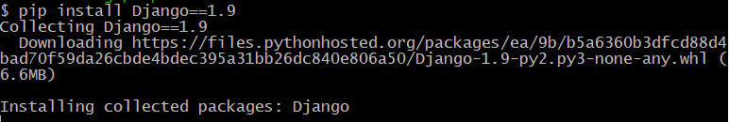
Testing the Activation
For example, let’s install a framework called Django.
pip install Django==1.9
The Django 1.9 package will be placed in virtualenv_name folder and will be isolated from the complete system.
Notes:
This begs the questions:
What’s the difference between these two executables anyway?
How is the virtual environment’s Python executable able to use something other than the system’s site-packages?
This can be explained by how Python starts up and where it is located on the system. There actually isn’t any difference between these two Python executables. It’s their directory locations that matter.
When Python is starting up, it looks at the path of its binary (which, in a virtual environment, is actually just a copy of, or symlink to, your system’s Python binary). It then sets the location of sys.prefix and sys.exec_prefix based on this location, omitting the “bin” portion of the path.

Slide 12
Deactivating the Virtual Environment
Once you are done with the work, you can deactivate the virtual environment by the following command:
deactivate
This puts you back to the system’s default Python interpreter with all its installed libraries.
To delete a virtual environment, just delete its folder.

Slide 13
END

